Slide 1
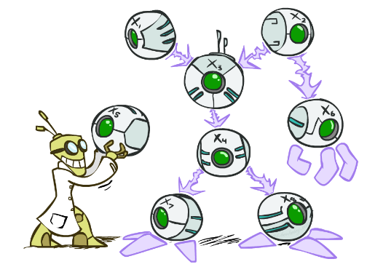
CS 188: Artificial Intelligence
Bayes’ Nets
Instructors: Dan Klein and Pieter Abbeel --- University of California, Berkeley
[These slides were created by Dan Klein and Pieter Abbeel for CS188 Intro to AI at UC Berkeley. All CS188 materials are available at http://ai.berkeley.edu.]
Notes:
Please retain proper attribution, including the reference to ai.berkeley.edu. Thanks!

Slide 2
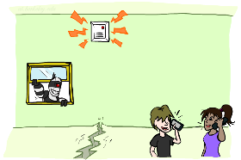
Example: Alarm Network
B | P(B)
+b | 0.001
-b | 0.999
E | P(E)
+e | 0.002
-e | 0.998
Burglary
Earthqk
Alarm
B | E | A | P(A|B,E)
+b | +e | +a | 0.95
+b | +e | -a | 0.05
+b | -e | +a | 0.94
+b | -e | -a | 0.06
-b | +e | +a | 0.29
-b | +e | -a | 0.71
-b | -e | +a | 0.001
-b | -e | -a | 0.999
John calls
Mary calls
A | J | P(J|A)
+a | +j | 0.9
+a | -j | 0.1
-a | +j | 0.05
-a | -j | 0.95
A | M | P(M|A)
+a | +m | 0.7
+a | -m | 0.3
-a | +m | 0.01
-a | -m | 0.99
Notes:
demo

Slide 3
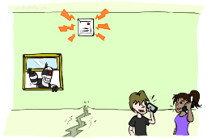

Example: Alarm Network
B | P(B)
+b | 0.001
-b | 0.999
B
E
E | P(E)
+e | 0.002
-e | 0.998
A
A | J | P(J|A)
+a | +j | 0.9
+a | -j | 0.1
-a | +j | 0.05
-a | -j | 0.95
A | M | P(M|A)
+a | +m | 0.7
+a | -m | 0.3
-a | +m | 0.01
-a | -m | 0.99
B | E | A | P(A|B,E)
+b | +e | +a | 0.95
+b | +e | -a | 0.05
+b | -e | +a | 0.94
+b | -e | -a | 0.06
-b | +e | +a | 0.29
-b | +e | -a | 0.71
-b | -e | +a | 0.001
-b | -e | -a | 0.999
J
M
Notes:
demo

Slide 4

Example: Alarm Network
B | P(B)
+b | 0.001
-b | 0.999
B
E
E | P(E)
+e | 0.002
-e | 0.998
A
A | J | P(J|A)
+a | +j | 0.9
+a | -j | 0.1
-a | +j | 0.05
-a | -j | 0.95
A | M | P(M|A)
+a | +m | 0.7
+a | -m | 0.3
-a | +m | 0.01
-a | -m | 0.99
B | E | A | P(A|B,E)
+b | +e | +a | 0.95
+b | +e | -a | 0.05
+b | -e | +a | 0.94
+b | -e | -a | 0.06
-b | +e | +a | 0.29
-b | +e | -a | 0.71
-b | -e | +a | 0.001
-b | -e | -a | 0.999
J
M
Notes:
demo

Slide 5

Inference
Inference: calculating some useful quantity from a joint probability distribution
Examples:
Posterior probability
Most likely explanation:

Slide 6




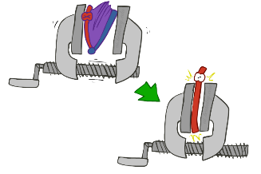
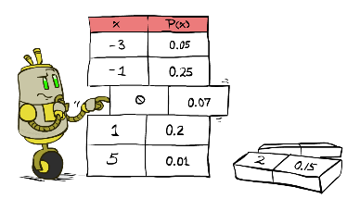



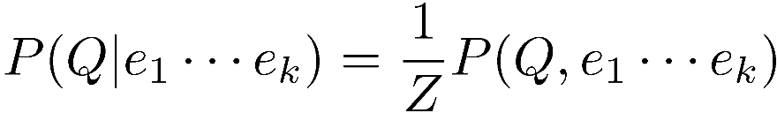
Inference by Enumeration
* Works fine with multiple query variables, too
General case:
Evidence variables:
Query* variable:
Hidden variables:
We want:
All variables
Step 1: Select the entries consistent with the evidence
Step 2: Sum out H to get joint of Query and evidence
Step 3: Normalize

Slide 7
Inference by Enumeration in Bayes’ Net
Given unlimited time, inference in BNs is easy
Reminder of inference by enumeration by example:
B
E
A
J
M

Slide 8
Inference by Enumeration in Bayes’ Net
P(+b|+j,+m)=P(+b,+j,+m)/P(+j,+m)
P(+b,+j,+m)
=P(+b,+e,+a,+j,+m)+P(+b,+e,-a,+j,+m)+P(+b,-e,+a,+j,+m)+P(+b,-e,-a,+j,+m)
=P(+b)P(+e)P(+a|+b,+e)P(+j|+a)P(+m|+a)+ P(+b)P(+e)P(-a|+b,+e)P(+j|-a)P(+m|-a)
+P(+b)P(-e)P(+a|+b,-e)P(+j|+a)P(+m|+a)+ P(+b)P(-e)P(-a|+b,-e)P(+j|-a)P(+m|-a)

Slide 9
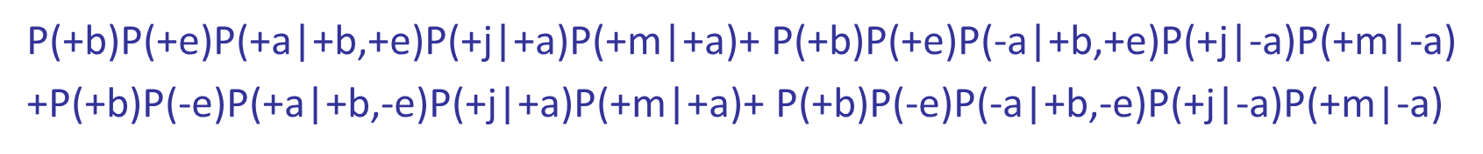
Example: Alarm Network
B | P(B)
+b | 0.001
-b | 0.999
B
E
E | P(E)
+e | 0.002
-e | 0.998
B | E | A | P(A|B,E)
+b | +e | +a | 0.95
+b | +e | -a | 0.05
+b | -e | +a | 0.94
+b | -e | -a | 0.06
-b | +e | +a | 0.29
-b | +e | -a | 0.71
-b | -e | +a | 0.001
-b | -e | -a | 0.999
A
A | J | P(J|A)
+a | +j | 0.9
+a | -j | 0.1
-a | +j | 0.05
-a | -j | 0.95
A | M | P(M|A)
+a | +m | 0.7
+a | -m | 0.3
-a | +m | 0.01
-a | -m | 0.99
J
M
=0.001X0.002X0.95X0.9X0.7+0.001X0.002X0.05X0.05X0.01
+0.001X0.998X0.94X0.9X0.7+0.001X0.998X0.06X0.05X0.01
=.000592
Notes:
demo

Slide 10
Inference by Enumeration in Bayes’ Net
P(+b|+j,+m)=P(+b,+j,+m)/P(+j,+m)
P(+b,+j,+m)=.0005922
P(+j,+m)=P(+b,+j,+m)+P(-b,+j,+m)
P(-b,+j,+m)
=P(-b,+e,+a,+j,+m)+P(-b,+e,-a,+j,+m)+P(-b,-e,+a,+j,+m)+P(-b,-e,-a,+j,+m)
=.0014917

Slide 11
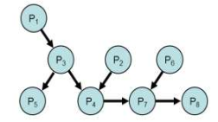
Independence in Bayes Nets
Every variable in a bayes net is inpendent of its non-descendents given its parents.
Determine if the following statements are True/False:
i.Pr(P8|P3,P7)=Pr(P8|P7)
ii.Pr(P3|P1,P5)=Pr(P3|P1)
iii.Pr(P4,P2|P3)=Pr(P4|P3)Pr(P2|P3)
iv.Pr(P5,P4|P1)=Pr(P5|P1)Pr(P4|P1)

